Slide 1
The High-Throughput Stochastic Human Exposure and Dose Simulation Model (SHEDS-HT) The Chemical and Products Database (CPDat)
Kristin Isaacs and Kathie Dionisio
National Exposure Research Laboratory
U.S. EPA, Office of Research and Development
The views expressed in this presentation are those of the authors and do not necessarily reflect the views or policies of the U.S. EPA
International Society for Exposure Science Annual Meeting
Pre-Conference Workshop
Utrecht, The Netherlands
October 9, 2016

Slide 2

Road Map
PART I: SHEDS-HT Background
Research problem and motivation
SHEDS-HT Overview
SHEDS-HT history, development, algorithms, and initial case study
PART II: Understanding and Using the Model (R Package)
Understanding SHEDS Terminology: Sources, Scenarios and Routes
Default Input Files
Run-Specific Input Files
Running the Model
Model Outputs and Postprocessing
Notes:
2

Slide 3
Road Map
PART III: The ProdComp Product Composition Module
Data Sources and Database Development: Chemicals, products, weight fractions, and functions
The “ProdComp” R package
PART IV: Tutorials
ProdComp: Running ProdComp queries and generating summary tables
ProdComp: Generating run-specific input files for SHEDS-HT
SHEDS-HT Set-up and run one of the SHEDS example runs
SHEDS-HT Set up and run the case study from ProdComp
Notes:
3

Slide 4
PART I: SHEDS-HT Background

Slide 5
Research Problem
The timely characterization of the human and ecological risk posed by thousands of existing and emerging commercial chemicals is a critical challenge facing EPA in its mission to protect public health and the environment
mg/kg BW/day
High throughput risk prioritization relies on three components – high throughput hazard characterization, high throughput exposure forecasts, and high throughput pharmacokinetics (i.e., dosimetry)
While advances have been made in HT toxicity screening, evaluated exposure and dosimetry prediction methods applicable to 1000s of chemicals are needed
Potential Hazard from in vitro with Reverse Toxicokinetics
Potential Exposure from ExpoCast
Lower
Risk
Medium
Risk
Higher
Risk
e.g. Judson et al., (2011)
Chemical Research in Toxicology
Notes:
5

Slide 6
Chemical Exposure Pathways
Data and Models
Chemical Manufacture
Consumer
Products, Articles, Building Materials
Environmental Release
Direct Use
(e.g., lotion)
Residential Use
(e.g. ,pesticides, flooring)
Waste
MEDIA
Air, Dust, Surfaces
Food
Air, Soil, Water
EXPOSURE
PATHWAY
(MEDIA + RECEPTOR)
Near-Field
Direct
Near-Field
Indirect
Dietary
Far-Field
Ecological
Ecological
Flora and Fauna
RECEPTORS
Human
MONITORING
DATA
Biomarkers
of Exposure
Media Samples
Biomarkers
of Exposure

Slide 7
Chemical Exposure Pathways
Data and Models
Chemical Manufacture
Consumer
Products, Articles, Building Materials
Environmental Release
Direct Use
(e.g., lotion)
Residential Use
(e.g. ,pesticides, flooring)
Waste
MEDIA
Air, Dust, Surfaces
Food
Air, Soil, Water
EXPOSURE
PATHWAY
(MEDIA + RECEPTOR)
Near-Field
Direct
Near-Field
Indirect
Dietary
Far-Field
Ecological
Ecological
Flora and Fauna
RECEPTORS
Human
MONITORING
DATA
Biomarkers
of Exposure
Media Samples
Biomarkers
of Exposure

Slide 8

Motivation: Importance of Near-Field Pathways
Uncertainty/Variability of NHANES Biomonitoring
~10% Far field (Industrial) Releases
~60% Indoor / Consumer Use
Systematic Empirical Evaluation of Models (Wambaugh et al. 2013, 2014)
Comparison of exposure model results with exposures inferred from NHANES
Better near-field models should reduce uncertainty
New data sources and models should explain more of variability and better characterize demographic differences
Mechanistic models should be better suited to extrapolation to additional chemicals if predictive ability can be demonstrated
Slide material from John Wambaugh

Slide 9
Systematic Empirical Evaluation of Models Framework (SEEM)
Apply calibration and uncertainty to other chemicals
EDSP Chemicals
QSARs and
HTE Data
Estimate Uncertainty
Calibrate models
Biomonitoring
Data
Inferred (Reverse) Exposure
Exposure Inference
Dataset 1
Dataset 2
…
Model 1
Forward Predictions
Model 2
…
Evaluate Model Performance
and Refine Models
Slide from John Wambaugh

Slide 10
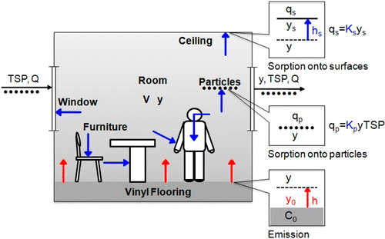
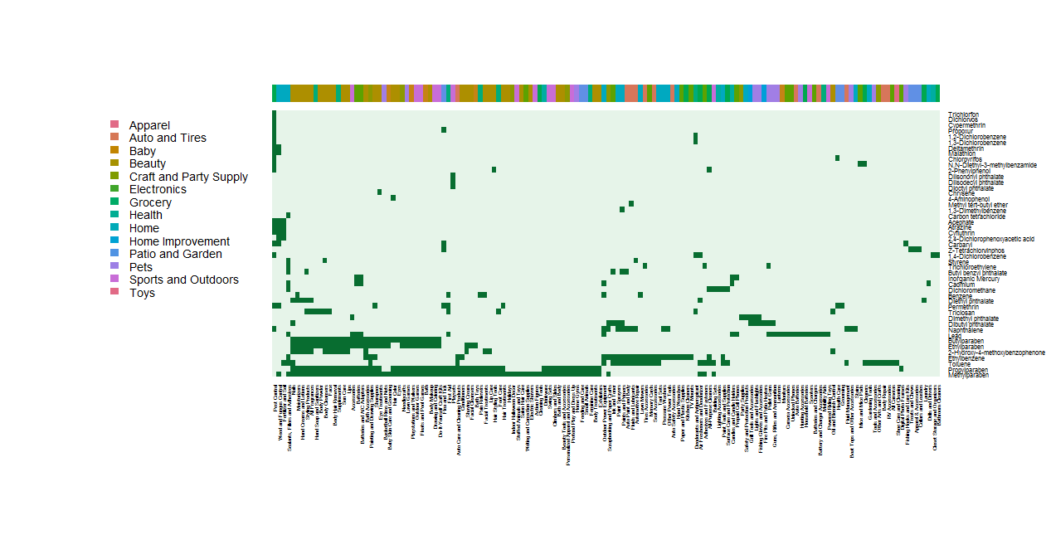
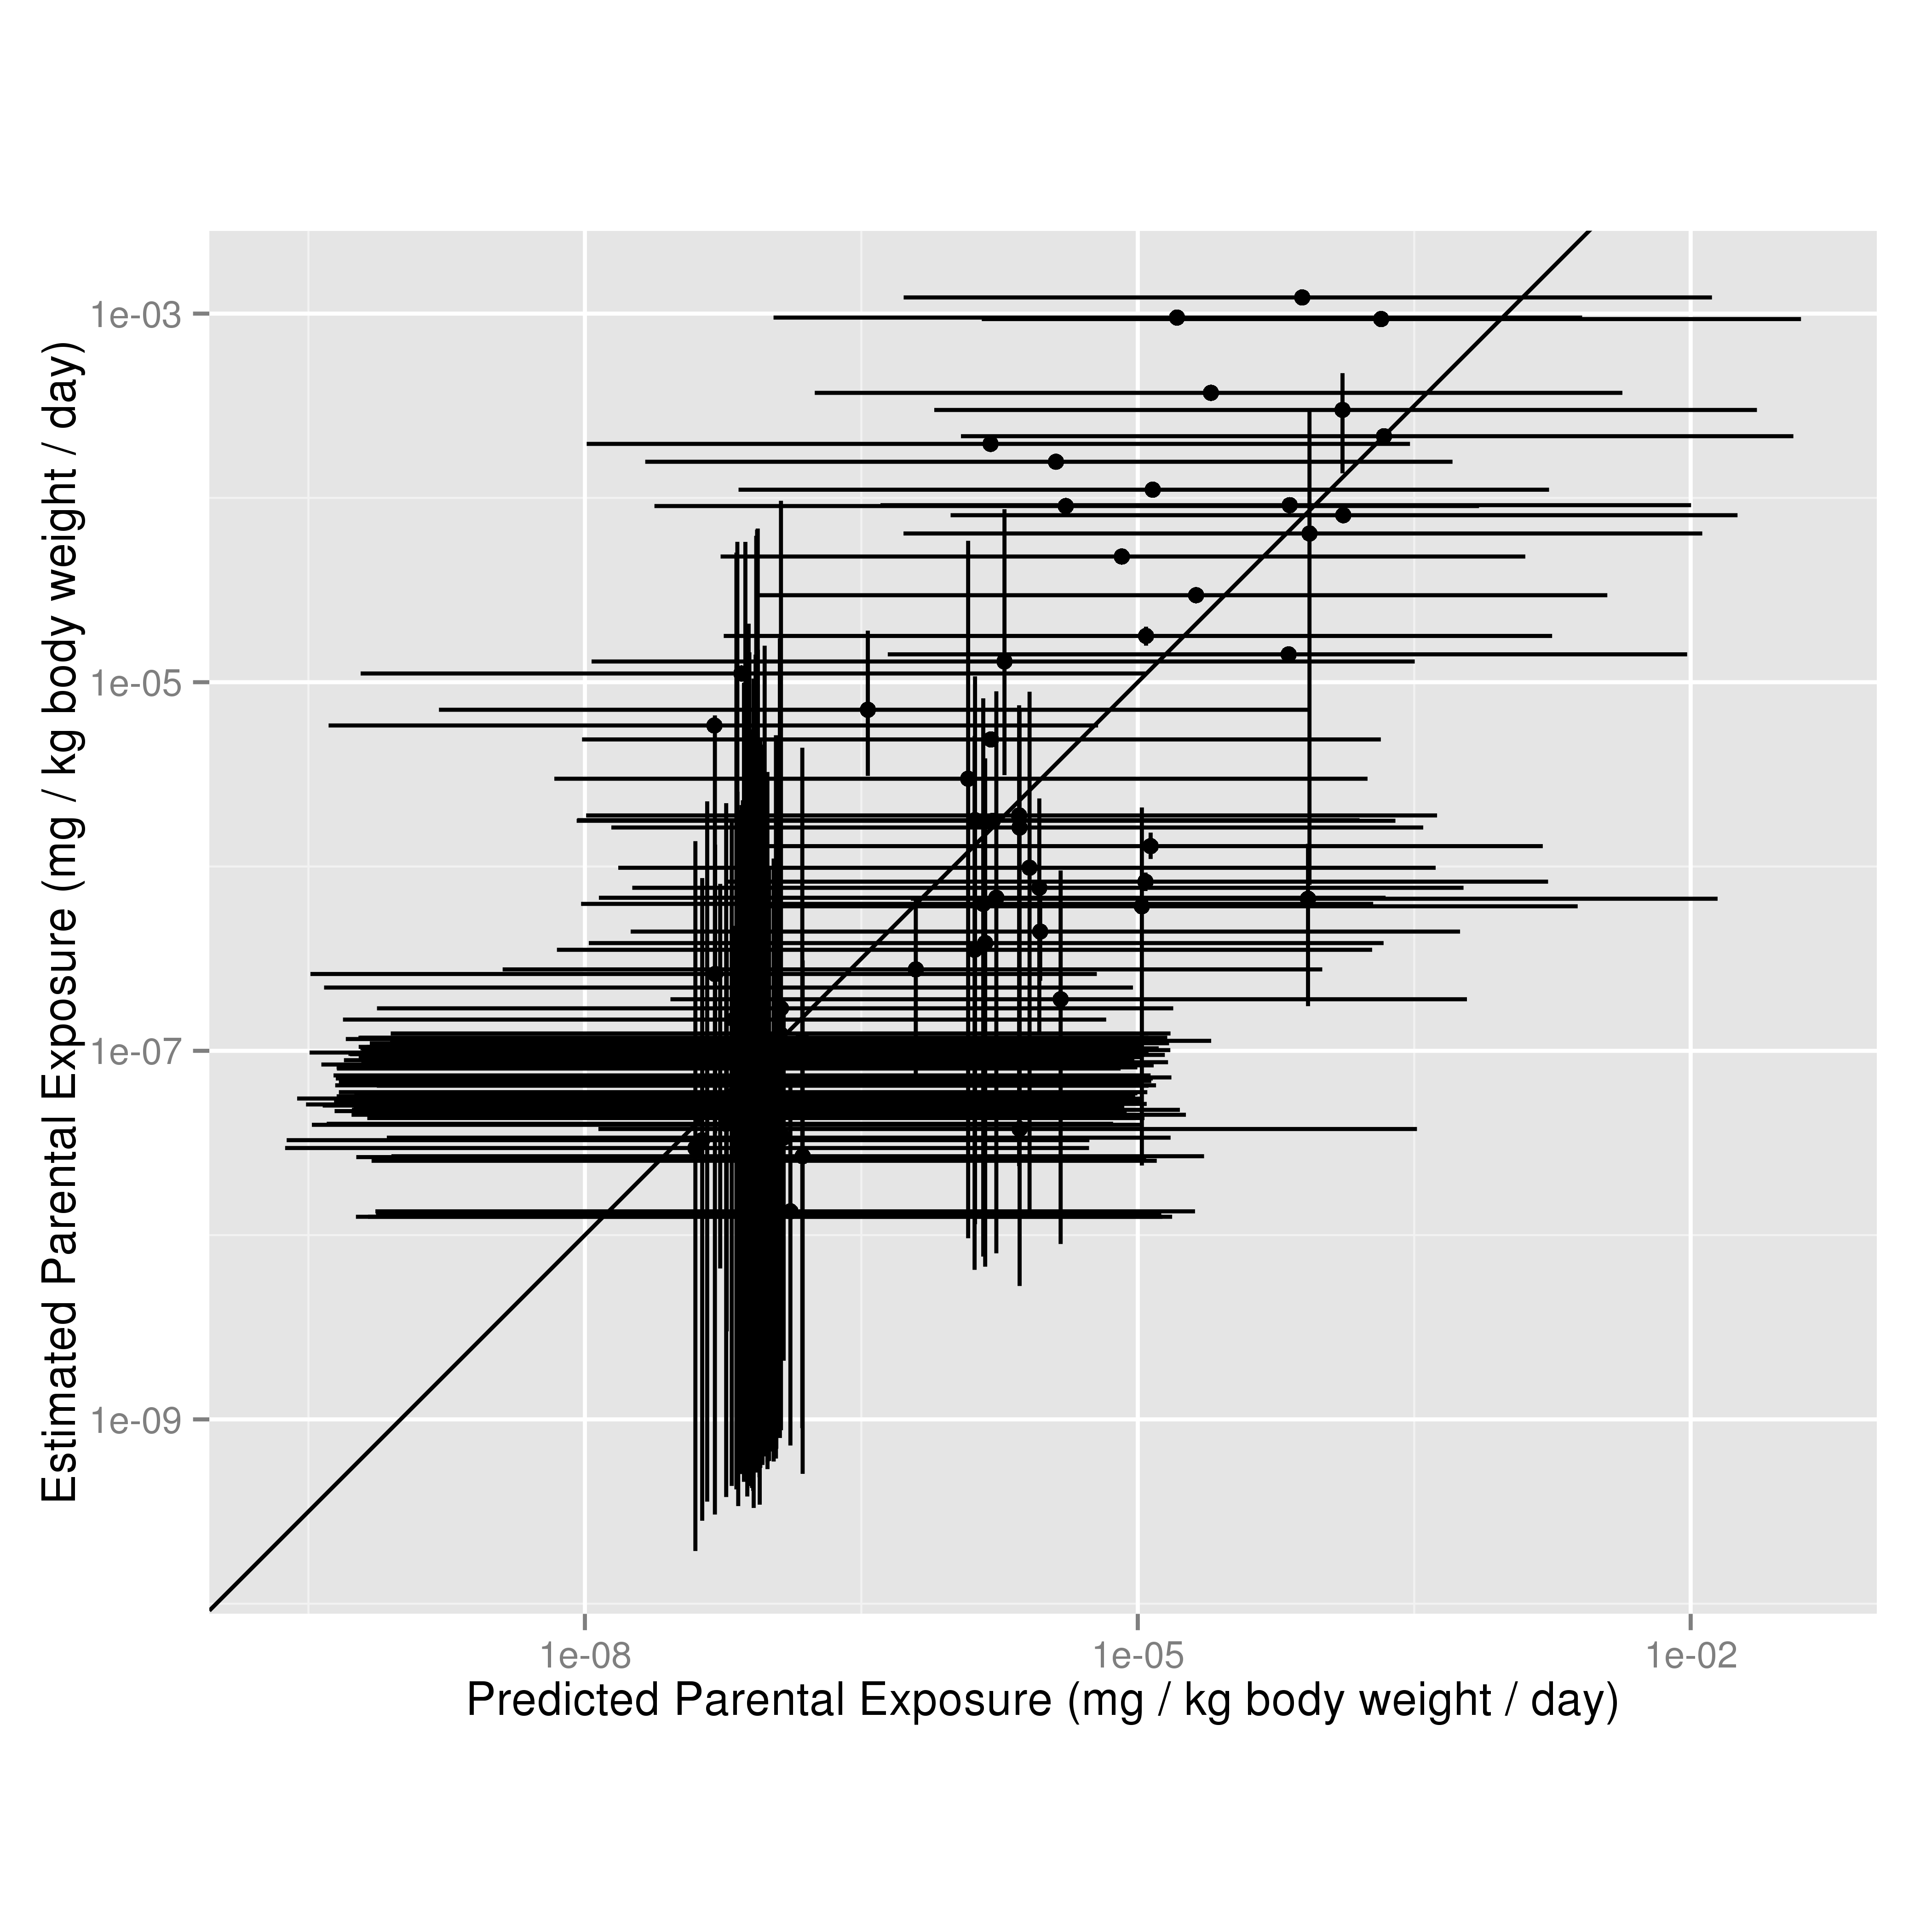
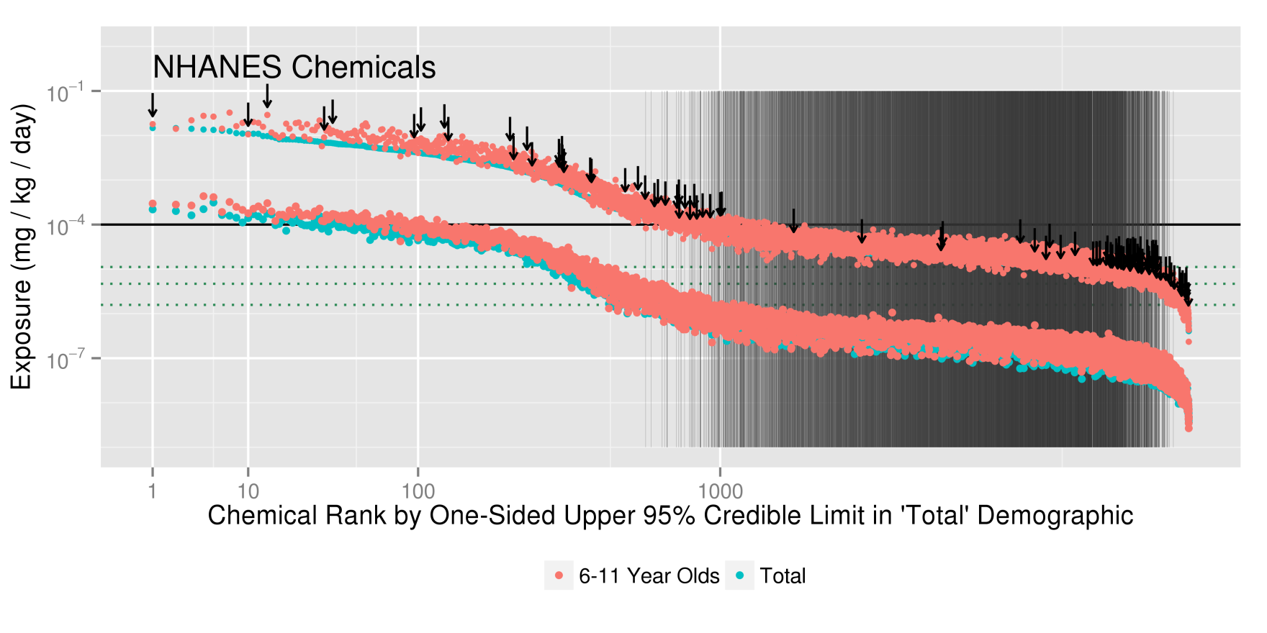
Third Generation SEEM Analysis
Chemical Information
from CPCPdb/CPCatDB
(updated/new heuristics)
Multiple Exposure Pathways
Predicted by SHEDS-HT
Other Near-Field Model Predictions
Little et al. model (2012)
RAIDAR and USEtox near-field exposures
Other new literature models
Systematic Evaluation Allows Model Evaluation/Refinement and
Extrapolation to
Updated Consensus Predictions

Slide 11
SHEDS-HT: The Basics
What does the model do (in a very general sense)?
What type of model is it?
How has it been used in the past?
How is the model supported, maintained, distributed, updated?

Slide 12

What does the model do?
SHEDS-HT predicts aggregate population-based human exposures to thousands of commercial chemicals in consumer products, consumer articles, and foods via inhalation, dermal, ingestion, and dietary pathways in a high-throughput manner.
Design Purpose: development of HT near-field exposure predictions for use in chemical prioritization

Slide 13
What does the model do?

Slide 14
What does the model do?

Slide 15
What does the model do?
Population Exposure
mg/kg/day

Slide 16
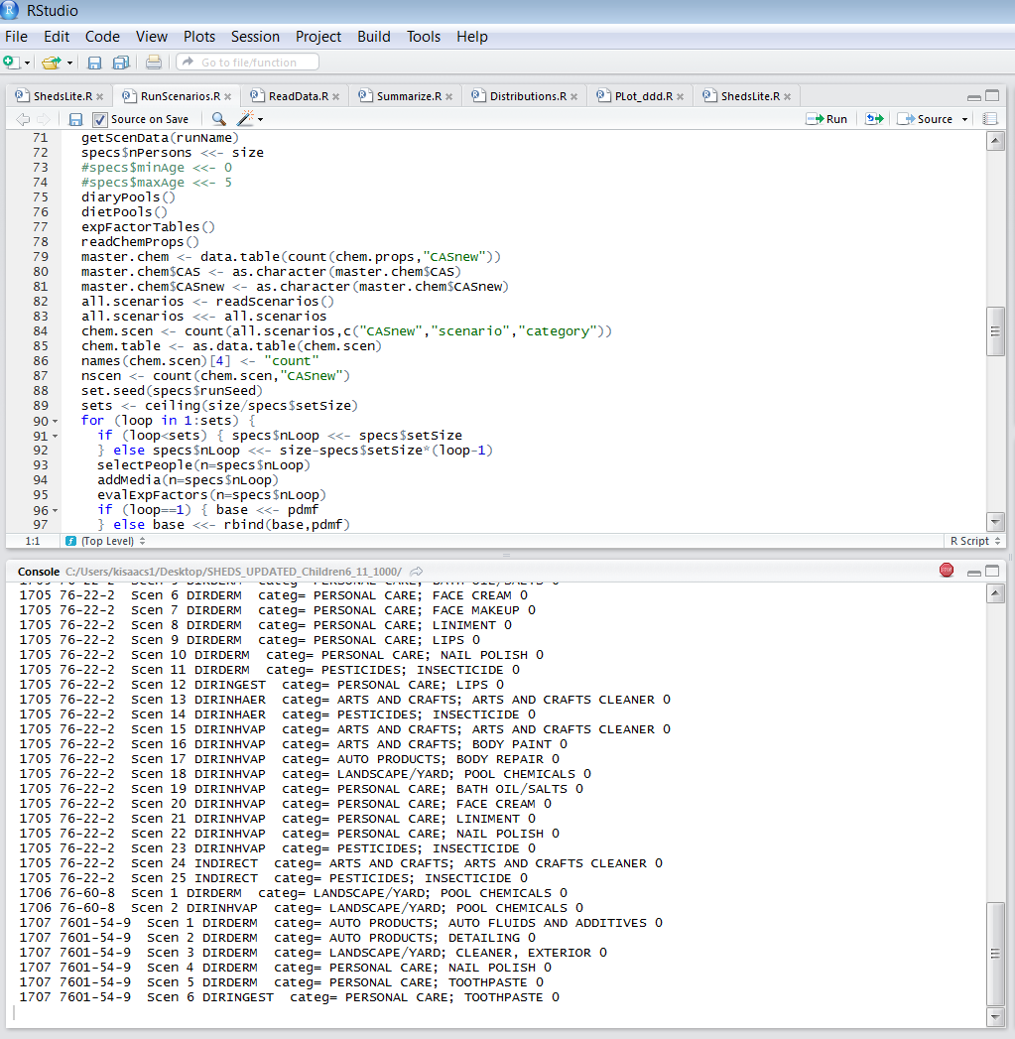
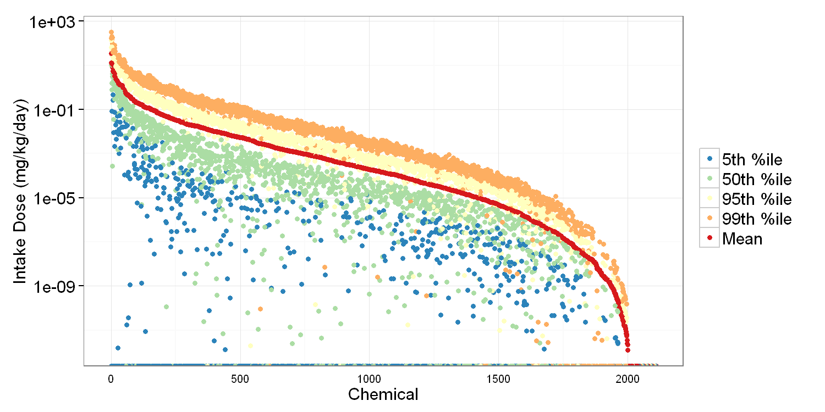
What type of model is it?
High-Throughput: Fit for specific purposes: screening and prioritization
Mechanistic: Algorithms designed to reflect real physical system and its processes
Stochastic: Monte-Carlo based model; takes distributions as inputs
Aggregate: single chemical exposures, multi-pathway and route
Population-based: simulates individuals; age-and gender differences in behaviors and data are included where possible
Cross-sectional: Single day simulation predicting chemical intake doses in mg/kg/day
Coded in the freely available R programming language
Inputs and outputs are text CSV files

Slide 17
Background and History: SHEDS-Multimedia
Methods
Glen et al. Longitudinal methods
Glen and Isaacs
Sensitivity analysis methods
Xue et al.
Hand-to-mouth data
Xue et al.
Object-to-mouth data
Xue et al. Longitudinal methods
Özkaynak et al.; Glen and Smith
Prototype model development and comparison to SHEDS-MM
Mokhtari et al. Sensitivity methods
Applications
Georgopoulos et al. Arsenic
Zartarian et al. Permethrin
Stout and Mason
Chlorpyrifos
Hore et al.
Chlorpyrifos
Özkaynak et al. Soil and dust
Isaacs et al.
SHEDS-HT
(2014)
Buck et al.
Chlorpyrifos
Stout et al. Diazinon
Xue et al. MeHg
Xue et al. Arsenic
Zartarian et al.
Chlorpyrifos
Zartarian et al.
CCA
Xue et al. CCA
Tulve et al. Pyrethroids
Zartarian et al. CCA
1999
2014
2011-2013
SHEDS-Lite
Development/
parameterization
(SAS/R)
2014
SHEDS-HT
Initial case study application
to 2500+
chemicals
2002-2005
Develop/apply
SHEDS-Wood for CCA
2 FIFRA SAPs
8/2007
FIFRA SAP review of SHEDS-Multimedia version 3
2007-2009:
Multimedia V.4, Including dietary module
2001
SHEDS-
Multimedia
version 2
(SAS and C++)
2010:
FIFRA SAP review
of SHEDS-MM
version 4
2004-2006
Develop
SHEDS-Multimedia v. 3

Slide 18
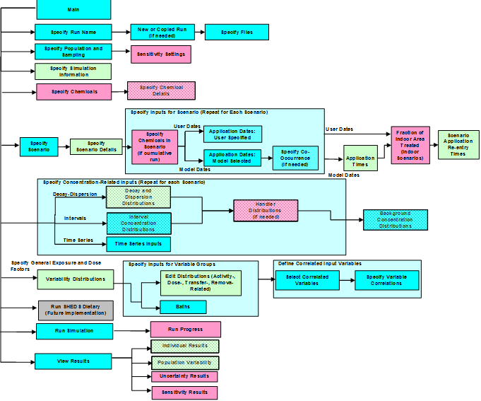
SHEDS-MM to SHEDS-HT
SHEDS-MM
SHEDS-HT
Reduced temporal resolution (daily)
Variance decomposition based sensitivity: elimination of minor inputs
Additional exposure scenarios (direct exposures to consumer products; emission from articles)
Reduced version of indoor emissions fugacity module
Low-to-mid tier
Appropriate for 1000s of chemicals
Retains population and life-stage information
R-based (freely available)
Fast execution (1000 person-days per chemical ~10 seconds)
Combined dietary/residential: aggregate predictions
Extendable to additional scenarios
High-tier
Minute-level time resolution
Best for single/few chemicals
SAS-based
Separate dietary/residential modules
40+ interface screens
~200 inputs/distributions
Longitudinal
Potentially long run times for large populations

Slide 19
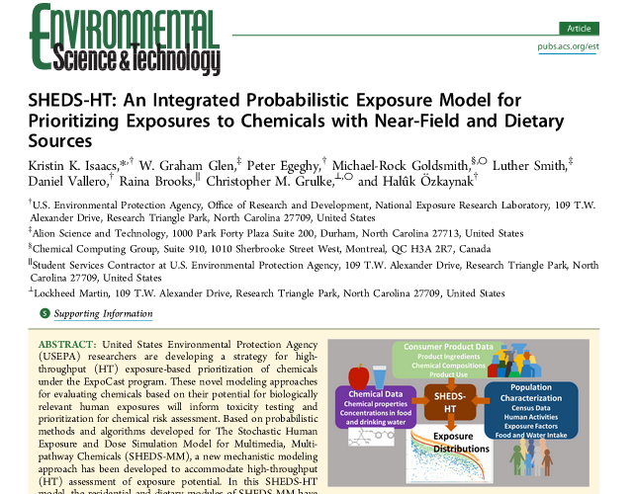
How Has The Model Been Used?
Used to estimate population exposures for 2500 consumer product chemicals and agricultural pesticides
Isaacs et al. Environmental Science and Technology, 2014, 48 (21), pp 12750–12759.

Slide 20
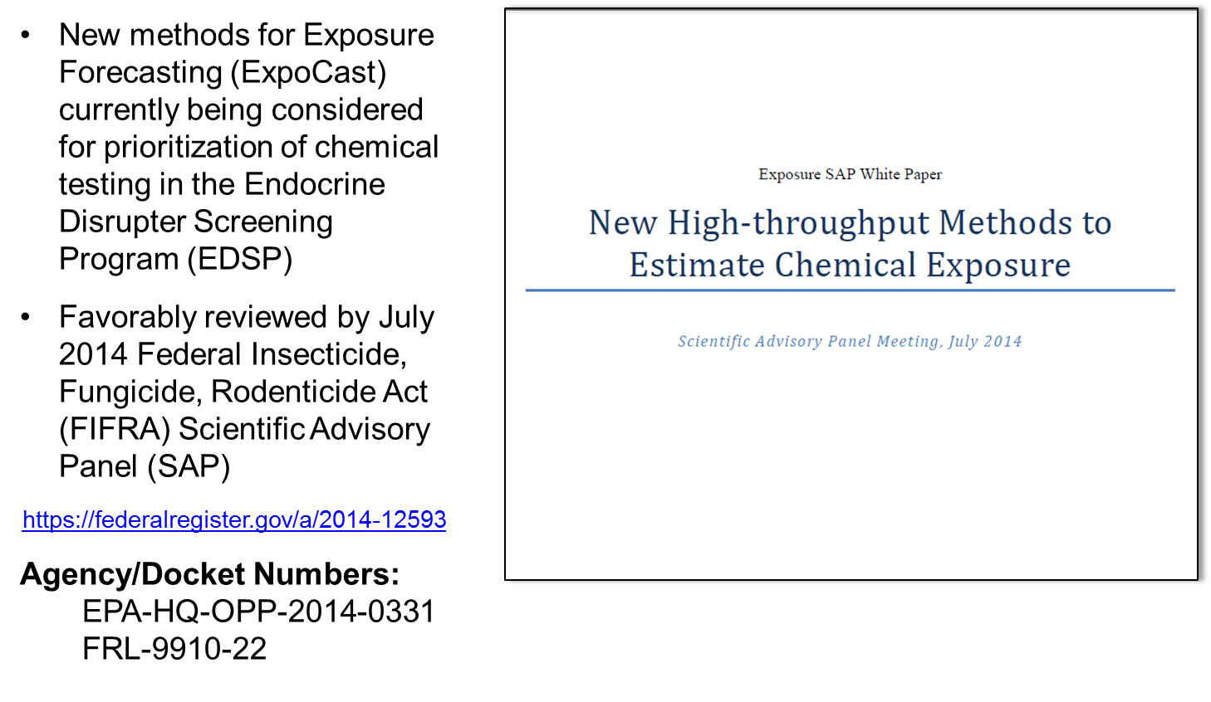
How Has The Model Been Used?

Slide 21
How is the model supported, maintained, distributed, updated?
Development and application supported under EPA’s Chemical Safety for Sustainability Program: Rapid Exposure and Dosimetry Project (includes ExpoCast): John Wambaugh, NCCT and Kristin Isaacs, NERL co-leads
FY14 version available in FIFRA SAP Docket
https://federalregister.gov/a/2014-12593
Agency/Docket Numbers: EPA-HQ-OPP-2014-0331/FRL-9910-22
Scientific model for a specific purpose (chemical prioritization) provided for transparency; model and input data may be useful to the scientific community

Slide 22

Recent SHEDS-Related Developments
Database of product composition information in part allow for custom parameterization of SHEDS (Parts III and IV of today’s Workshop)
SHEDS-HT Beta Version B.1 and R package
Reconfigured input files, sustainable structure, suited for external users
Documentation (Technical Manual and R package help documentation)
Allows for incorporation of new exposure scenarios into aggregate exposures (article emission and migration from food contact materials)
Notes:
Figure 33: Consumer Product Chemical Profile Data curation/annotation workflow: Approximately 10,000 MSDSs were identified, parsed, and manually annotated through a custom-built curation system. Figure from Goldsmith et al. ([67])
To get info on ingredients of consumer products beyond what is in HPDB we turned to Walmart
Walmart provides MSDSs on all products they sell via their website as part of their sustainability initiative
Also extracted their retail product categories from their commerce website
Rocky’s network diagram shows connections between chemicals and product categories
Info on ingredients mapped to product categories and to exposure scenarios

Slide 23
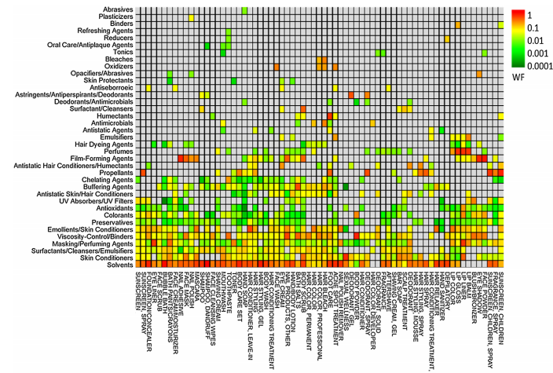
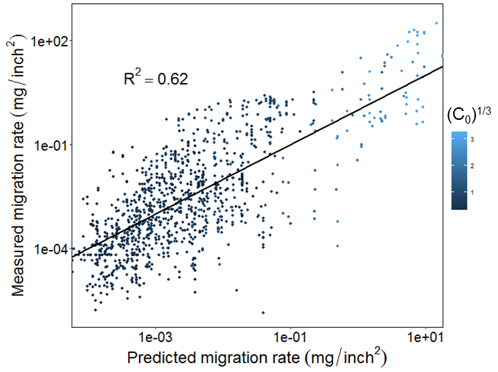
Recent Scientific Development
Prediction of chemical functions and weight fractions in personal care products (in part for parameterization of SHEDS) Isaacs et al., Toxicology Reports, 2016
High-Throughput Dietary Exposure Predictions for Chemical Migrants from Food Contact Substances for Use in Chemical Prioritization. Derya Biryol et al. (submitted to Environment International)

Slide 24
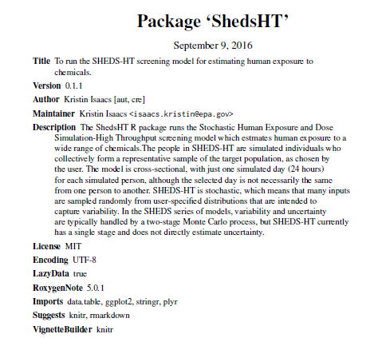
R Package ‘ShedsHT”
R Package with help documentation and User’s Guide
Default input files (e.g. population, food diaries)
Example run-specific input files

Slide 25
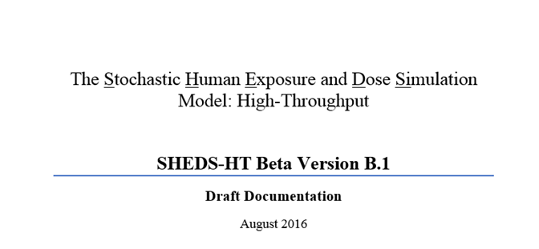
R Package ‘ShedsHT”
R Package with help documentation and User’s Guide
Default input files (e.g. population, food diaries)
Example run-specific input files

Slide 26

R Package ‘ShedsHT”
R Package with help documentation and User’s Guide
Default input files (e.g. population, food diaries)
Example run-specific input files
Will try to reference relevant sections:
SHEDS Technical Manual Table 1.

Slide 27
SHEDS-HT: Overview
Stochastic Human Exposure and Dose Simulation Model (SHEDS) – High Throughput (HT)
Developed from ORD’s higher-tier SHEDS-Multimedia exposure model
Produces population-level distributions of exposures to chemicals with near-field sources
Calculates aggregate exposures to chemicals from relevant exposure scenarios (including different consumer products containing a chemical), via multiple routes

Slide 28
General SHEDS Approach
Input Databases
Algorithms
Output
Census
Human Activity
Food Consumption
Product Usage Data
Exposure Factor Distributions
Calculate Media Concentrations
Calculate Individual Daily Exposures/Doses:
Population Exposure
Monte Carlo
Simulation
Population Dose
Dermal
Inhalation
Non-Dietary Ingestion
Dietary Ingestion
Total Intake

Slide 29
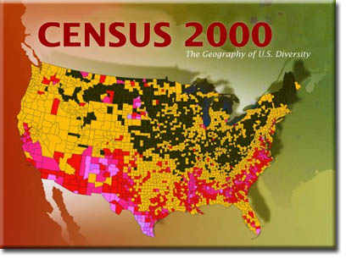




Population Generation
Male, age 4
Relevant exposure factors
(e.g. weight, bathing and hand
washing behaviors, hand-to mouth
behaviors)
Match age and gender
Daily-level activity diary
Time spent in microenvironments
Energy expenditure (ventilation)
Daily-level food diary
(grams consumed per food group)

Slide 30
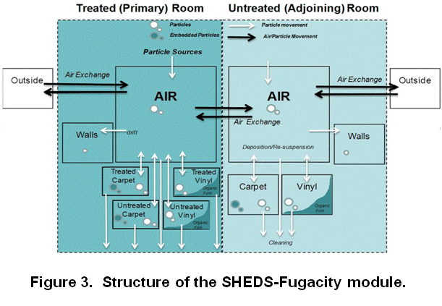
Fugacity-based Indoor Fate and Transport Module
Starting point: 10-compartment indoor fate and transport model developed for use with SHEDS-Multimedia (based on Bennett and Furtaw, ES &T, 2004)
Reduced via variance decomposition based sensitivity analyses (implementation of Sobol’s analysis using correlations; Glen and Isaacs, Environmental Modelling and Software, 2012)
Number of compartments reduced to match SHEDS-HT (air/surfaces)
Module was parameterized with previously developed distributions for housing characteristics and particle properties
Chemical Properties predicted with EPA’s EPI-Suite
Reduced via
sensitivity analyses
Critical Parameters:
Vapor Pressure
Decay Rates on Surfaces
Air Exchange Rates
K_{ow}
Solubility

Slide 31
SHEDS-HT Exposure Scenarios
Dietary Ingestion
Incidental Direct Ingestion of
Product
Direct Inhalation of Vapor from Product
Direct Inhalation of Aerosol
From Product
Direct Dermal Application
Of Product
Indirect Exposure to Bolus Applied Product
Indirect Exposure to Constant Emission of Chemical
Down the Drain
Release of Chemical

Slide 32


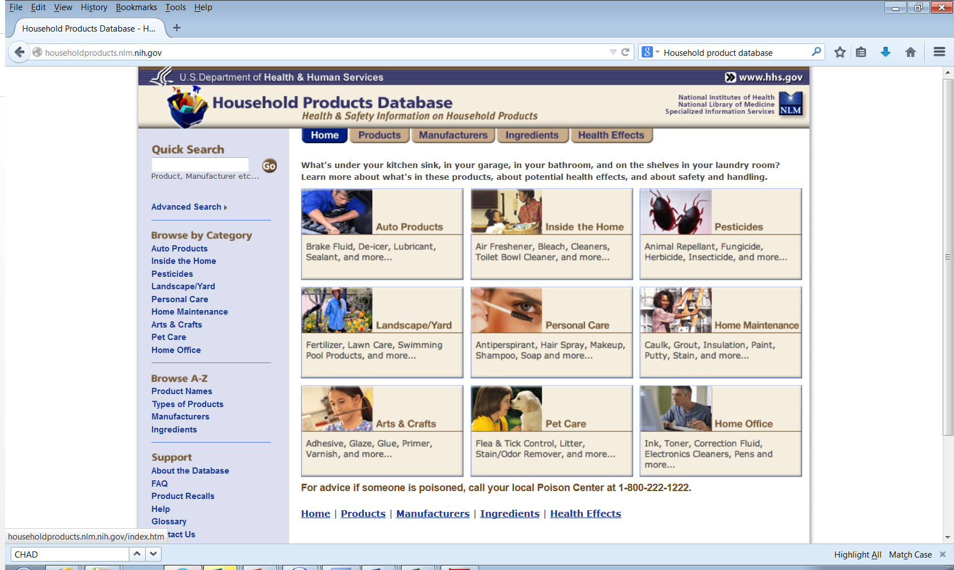

Initial Case Study: Chemicals in Consumer Products and Pesticides in Foods and Drinking Water
Consumer Product Chemical Profile Database (CPCPdb)
Goldsmith et al., Food and Chemical Toxicology, 2014
Curated from retailer-provided material data safety sheets (MSDS) using both automated and manual methods
Chemical ingredients by product, including % composition where available
Mapped to consumer product retail category, product name available for additional categorizations
Totals: 1797 chemicals in 8921 products
Household Product Database (HPDB) - National Library of Medicine
MSDS-based
Totals: 3864 chemicals/substances in 12073 products
Tiered product categorization
Pesticide Data Program (PDP) - United States Department of Agriculture
Distributions of residues in foods and drinking water 1997-2011
330 pesticides
Notes:
Figure 33: Consumer Product Chemical Profile Data curation/annotation workflow: Approximately 10,000 MSDSs were identified, parsed, and manually annotated through a custom-built curation system. Figure from Goldsmith et al. ([67])
To get info on ingredients of consumer products beyond what is in HPDB we turned to Walmart
Walmart provides MSDSs on all products they sell via their website as part of their sustainability initiative
Also extracted their retail product categories from their commerce website
Rocky’s network diagram shows connections between chemicals and product categories
Info on ingredients mapped to product categories and to exposure scenarios

Slide 33
PART II: Understanding and Using the SHEDS-HT Model (and R Package)

Slide 34
Understanding SHEDS-HT Terminology: Chemicals, Sources, Scenarios, Routes and Runs

Slide 35
Chemicals
Any compound for which chemical properties needed for the model can parameterized
Kp: the skin permeability constant in which SHEDS uses to determine dermal absorption [cm/hr].
MW: molecular weight in [g/mol] of the target chemical.
VP.Pa: vapor pressure in [Pa].
Log.Kow: the base ten logarithm of the octanol-water partition coefficient
Water.sol.mg.l: solubility in units of [mg/L]
Half.sediment.hr: Half-life in sediment (hours), as predicted by the EPI-Suite Level III Fugacity model. Used to estimate the decay of chemicals indoors.
Half.air.hr: Half-life in air (hours), as predicted by the EPI-Suite Level III Fugacity model. Used to estimate the decay of chemicals indoors.
R package provides default values from EPI-Suite for 2422 chemicals in consumer products
EPA CompTox Dashboard provides data (including measured and modeled properties where available) for over 720,000 chemicals: https://comptox.epa.gov/dashboard

Slide 36



Sources
A SOURCE can be thought of as the means (or carrier) by which a chemical enters the near-field environment
SHEDS-HT can handle unlimited number of sources
SHEDS allows three SOURCE types:
FOOD
PRODUCT
ARTICLE
Each source in SHEDS maps to one or more SCENARIOS
FOOD
PRODUCT
(formulation)
ARTICLE
(solid)

Slide 37
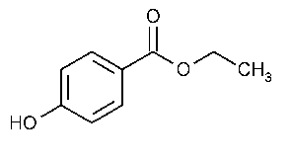
Scenarios
A SCENARIO is the mechanism by which chemical from the SOURCE comes into contact with the receptor (usually the simulated human) resulting in exposure
Each SOURCE is mapped to one or more SCENARIOS
Each SCENARIO has its own unique set of exposure equations
Defines the parameters the model expects
SHEDS-HT has nine unique SCENARIOS:
Source
Scenario
Receptor
FOOD
PRODUCT
ARTICLE
Food.residue: Consumption of food containing a known chemical residue
Product.direct.dermal: Direct application of chemical to skin (either purposefully or incidentally) during use of a consumer product
Product.direct.ingestion: Incidental ingestion of a consumer product during use (not including hand-to-mouth)
Article.emission: Exposure due to Emission of chemical from an article in the home (e.g. furnishings)
Food.migration: Consumption of food containing chemical present due to migration from packaging or other contact materials
Product.direct.inhalationAerosol: Inhalation of aerosol during use of a consumer product
Product.direct.inhalationVapor: Inhalation of vapor during use of a consumer product
Product.Indirect: Application of consumer product to environment leading to subsequent exposures (indirect)
Product.downthedrain: A unique exposure scenario calculating the down the drain mass associated with use of a consumer product
SHEDS Technical Manual Table 1.

Slide 38
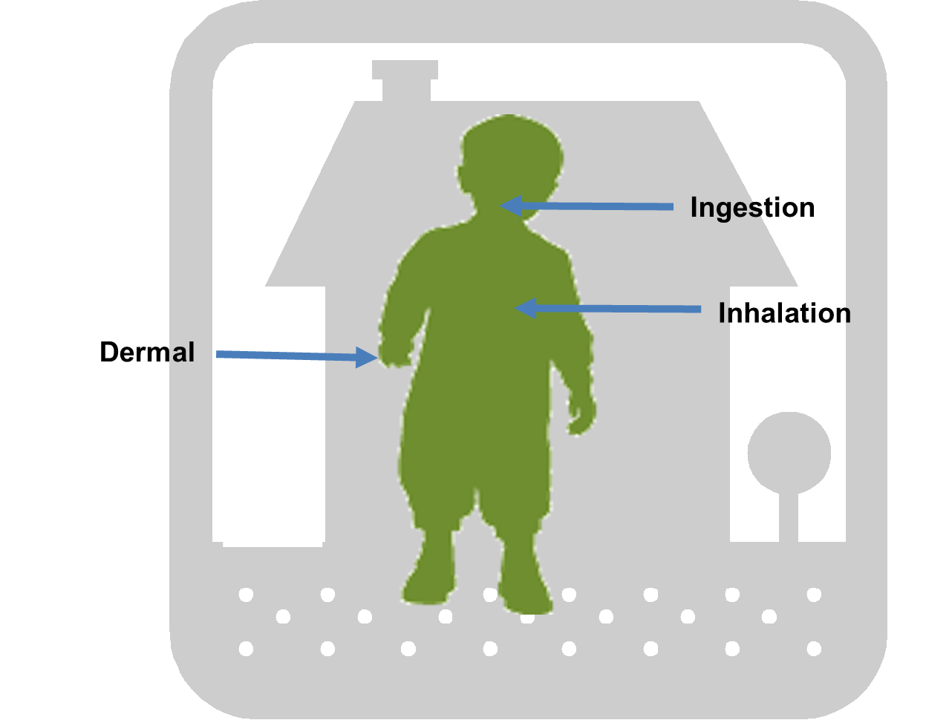
Route
A ROUTE is the pathway by which the chemical enters the human body
Dermal
Inhalation
Ingestion
Each SCENARIO results in exposure via one or more ROUTES
Each ROUTE has exposure and absorbed dose values
ROUTE exposures and doses are aggregated over SCENARIOS for each SOURCE and over each SOURCE
ROUTES each have an absorption fraction, all combine to get absorbed dose

Slide 39
Route
A ROUTE is the pathway by which the chemical enters the human body
Dermal
Inhalation
Ingestion
Each SCENARIO results in exposure via one or more ROUTES
Each ROUTE has exposure and absorbed dose values
ROUTE exposures and doses are aggregated over SCENARIOS for each SOURCE and over each SOURCE
ROUTES each have an absorption fraction, all combine to get absorbed dose
Food.migration
Ingestion
Product.direct.dermal
Dermal, Ingestion
Product.Indirect
Dermal, Ingestion, Inhalation
Product.direct.inhalationVapor
Inhalation

Slide 40


Exposure Scenarios
SHEDS Technical Manual Sections 4.6.3-4.6.6.
Product.Direct Scenarios
Formulated similarly to other available models; probabilistic
Dependent on source-specific frequency of consumer product use, population prevalence, mass of product used, and product chemical weight fraction (composition)
Dermal: fraction retained on skin, fraction in contact with skin
Inhalation: aerosol mass or vapor: depends on Vp or fraction aerosolized
Ingestion: fraction ingested during use

Slide 41


Exposure Scenarios
SHEDS Technical Manual Sections 4.6.8 and 4.6.9.
Product.Indirect and Article.Emission Scenarios
Fugacity module is used to model the fate and transport of chemical within a home
Bolus application: media concentrations calculated for a sampled day from last application based on frequency of consumer product use
Constant emission: air concentrations due to area emission source based on steady-state air concentration at surface (y_{0,} as in Little et al. 2013); other media concentrations via fugacity-based partitioning
Individuals breathe indoor air or touch contaminated surfaces post-use, resulting in exposure via inhalation, dermal, and ingestion (object-to-mouth, and hand-to-mouth) routes

Slide 42
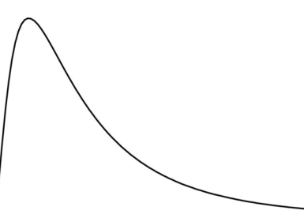
Exposure Scenarios
SHEDS Technical Manual Section 4.6.1
Food.Residue Scenarios
Consistent with SHEDS-MM dietary methods (by Xue et al.) reviewed during the 2010 FIFRA SAP
Consumption data: NHANES What We Eat In America (1999-2010)
Mapped to agricultural commodities using EPA Food Commodity Intake Database (FCID) recipe files
General SHEDS Dietary Input file is aggregated by by crop group
Other groups could be used
Aggregated to daily level – mass per food group
Residue Distribution by Food Group
Continuous or Empirical
NHANES-WWEIA
Mass of Commodity
Consumed
Concentration in food group
= Dietary Exposure
X

Slide 43
Exposure Scenarios
SHEDS Technical Manual Section 4.6.2
Food.Migration Scenario
Similar to the Food.Residue scenario
SHEDS does not currently contain methods for estimating migration (Biryol et al. submitted)
Concentrations distributions or empirical values must be provided Two additional factors
NHANES-WWEIA
Probability of Food Contact Substance
Containing
Chemical
Fraction of Food in Group Contacting FCS
Dietary Exposure
Mass of Commodity
Consumed
X
Concentration in food group
X
X
=

Slide 44



Dermal Removal Processes, Hand-to-Mouth Transfer, and Absorption by Route
For each chemical, determining exposure contribution of each to each route from all sources/scenarios
Apply dermal removal processes: bathing, handwashing, dermal absorption, brush-off, hand-to-mouth transfer and calculate final dermal and ingestion exposures
Apply route-specific absorption fractions and sum across routes to achieve total intake dose in mg/kg/bw-day
Five Competing Removal Processes for Dermal Exposure
bathing
hand-to-
mouth
hand-washing
brush-off
Skin
Blood
absorption
SHEDS Technical Manual Sections 4.7 and 4.8

Slide 45
Example of Linkage Chemicals, Sources, Scenarios, and Routes in a SHEDS Run
Chemical X in 4 SOURCES
Source Type
Source
Scenario
Routes
FOOD
Asparagus
food.residue
FOOD
Milk
Dermal
food.migration
Ingestion
Inhalation

Slide 46
Example of Linkage Chemicals, Sources, Scenarios, and Routes in a SHEDS Run
Chemical X in 4 SOURCES
Source Type
Source
Scenario
Routes
FOOD
Asparagus
food.residue
FOOD
Milk
Dermal
food.migration
Ingestion
Inhalation
Product.direct.dermal
PRODUCT
Hand/Body Lotion
Product.direct.inhalationofVapor

Slide 47
Example of Linkage Chemicals, Sources, Scenarios, and Routes in a SHEDS Run
Chemical X in 4 SOURCES
Source Type
Source
Scenario
Routes
FOOD
Asparagus
food.residue
FOOD
Milk
Dermal
food.migration
Ingestion
Inhalation
Product.direct.dermal
PRODUCT
Hand/Body Lotion
Product.direct.inhalationofVapor
PRODUCT
Insecticide
Product.indirect

Slide 48
Example of Linkage Chemicals, Sources, Scenarios, and Routes in a SHEDS Run
Chemical X in 4 SOURCES
Source Type
Source
Scenario
Routes
FOOD
Asparagus
food.residue
FOOD
Milk
Dermal
food.migration
Ingestion
Inhalation
Product.direct.dermal
PRODUCT
Hand/Body Lotion
Product.direct.inhalationofVapor
Dermal Removal Processes, Hand-to-Mouth Transfer, and Final Absorption by Route
PRODUCT
Insecticide
Product.indirect
TOTAL
ABSORBED
DOSE
Mg/kg-BW/day

Slide 49
A Model Run: Parameterization, Input Files, and Output Files

Slide 50
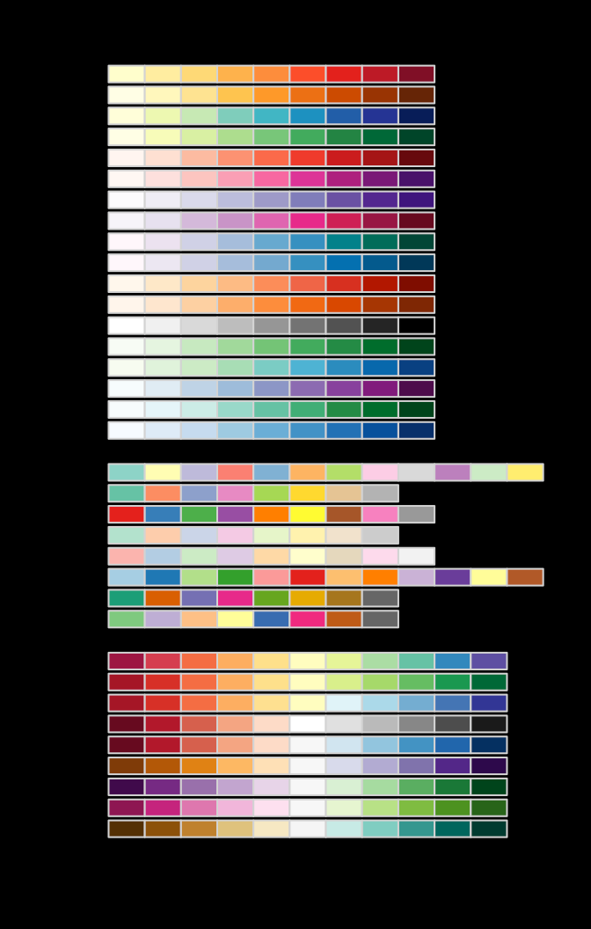
Model Overview
START RUN
Read Input Files
Initialize Chemicals and Sources to be run
Run-Specific Input Files
Generate Population
Run File
Source-Scenario File
Source-Chemical File
Source-Variable File
Generate Exposure Factors
Generate Source Variables for Population
Loop Over Chemicals
General Input Files
Loop Over Sources
Activity Diary File
Chemical Property File
Dietary Diary File
Exposure Factor File
Fugacity File
Media File
Physiology File
Population File
Food.residue
Calculate Exposures for Active Scenarios for Population
Food.migration
Run Fugacity Module
(calculate media concs)
Product.Indirect
Product.direct.inhalationVapor
Product.direct.inhalationAerosol
Update Route
Exposures
Product.direct.ingestion
Product.downthedrain
Product.direct.dermal
Run Fugacity Module
(calculate media concs)
Article.emission
Summarize Source
Dermal Removal Processes, Hand-to-Mouth Transfer, and Absorption
Summarize Chemical
END RUN

Slide 51
Parameterization of Sources
Source Type
Source
Scenario
Product
Hand/Body Lotion
Product.direct.dermal

Slide 52
Parameterization of Sources
Source Type
Source
Scenario
Product
Hand/Body Lotion
Product.direct.dermal
SHEDS Technical Manual Table 2.
Source-Specific Variables
Source Chemical-Specific Variables
use.prev | Fraction of population using the source
use.freq | Number of times per year the source is used
mass | Mass in grams of product per use
f.contact | Fraction of product mass contacting skin
f.residual | Fraction of contacting mass remaining on skin after product use
chem.prev | Likelihood (probability between 0-1) this source type contains the chemical of interest
f.chemical | Fraction of product weight that is this chemical (if not zero)

Slide 53
Parameterization of Sources
Source Type
Source
Scenario
Product
Hand/Body Lotion
Product.direct.dermal
SHEDS Technical Manual Table 2.
Source-Specific Variables
Source Chemical-Specific Variables
use.prev | Fraction of population using the source
use.freq | Number of times per year the source is used
mass | Mass in grams of product per use
f.contact | Fraction of product mass contacting skin
f.residual | Fraction of contacting mass remaining on skin after product use
chem.prev | Likelihood (probability between 0-1) this source type contains the chemical of interest
f.chemical | Fraction of product weight that is this chemical (if not zero)
Indexed by CAS or other ID
If missing, chemical(s) not run
If present, chemicals are run
Used for all chemicals in source
Used by one or more scenarios
If missing, SHEDS writes error informing of missing info

Slide 54
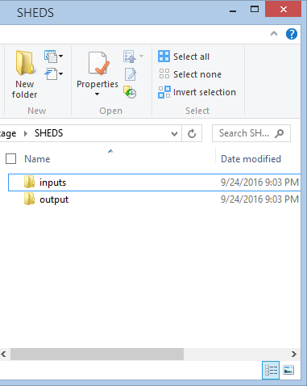
SHEDS Directory Layout
We will cover set-up from R package and other details in Part IV Tutorials

Slide 55
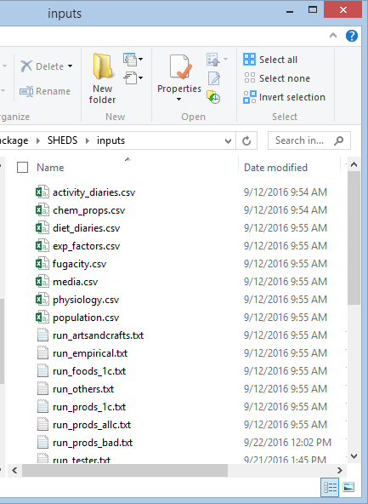
SHEDS Directory Layout
We will cover set-up from R package and other details in Part IV Tutorials
Input and Run Files

Slide 56
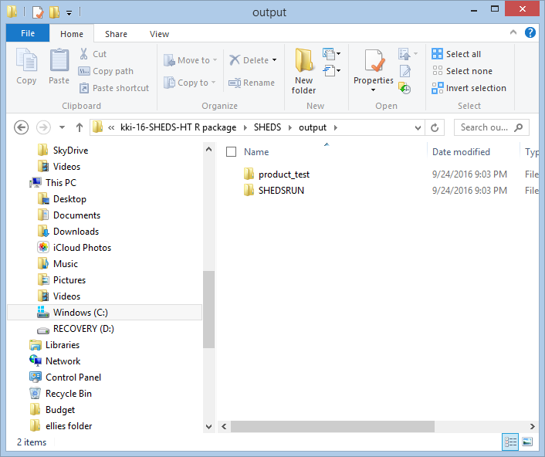
SHEDS Directory Layout
We will cover set-up from R package and other details in Part IV Tutorials
Completed Runs

Slide 57
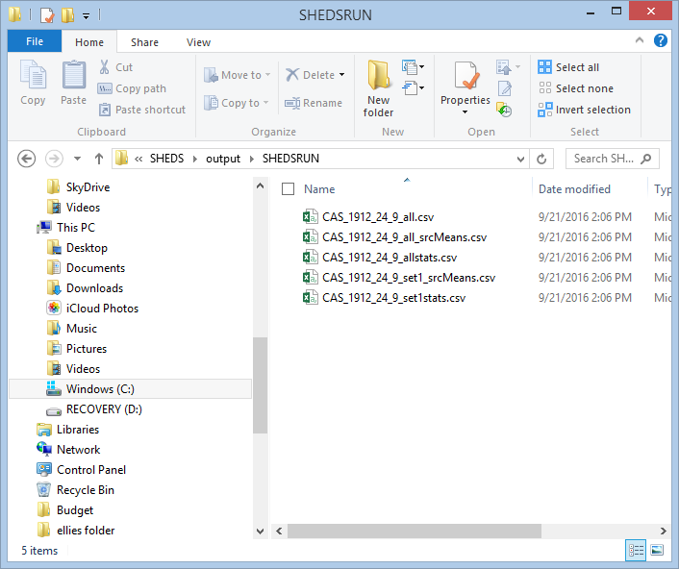
SHEDS Directory Layout
We will cover set-up from R package and other details in Part IV Tutorials
Output Files

Slide 58
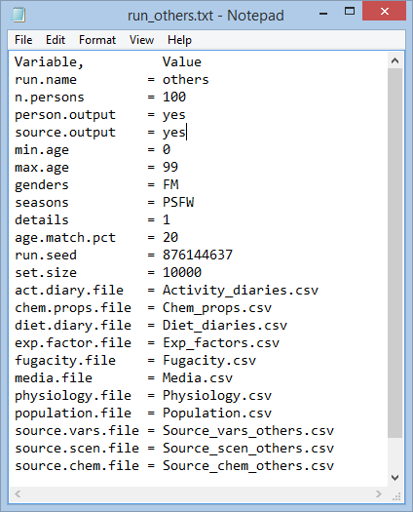
Run File
Text file
Main control file for each run
General settings
Input files to be used for the run

Slide 59
SHEDS General Input Files (Not Run-Specific)
SHEDS Technical Manual Table 3.
File | Keyword in Run File | Description | Source for Default Information
Activity Diary File | act.diary.file | Daily location (time spent in microenvironments) and activity (physical activity index PAI, a time-averaged metabolic equivalent) information for each age- and gender-specific CHAD diary | Calculated from USEPA’s CHAD
Chemical Property File | chem.props.file | Chemical-specific property information by CAS number | Derived from EPI Suite
Dietary Diary File | diet.diary,file | Daily mass of food group (by default crop group) consumed by individuals | Calculated from NHANES-WWEIA food diaries
Exposure Factor File | exp.factor.file | Distributions for various human exposure factors | From Exposure Factors Handbook and analysis of other models
Fugacity File | fugacity.file | Distributions for house variables needed for fugacity modeling | Mainly developed from Bennett and Furtaw (original indoor fate and transport model)
Media File | media.file | List of media in each micro that may contain chemicals | N/A
Physiology File | physiology.file | Body mass, height, and basal metabolic rate distributions or regressions by age/gender cohort | Developed for SHEDS-Multimedia from NHANES
Population File | population.file | Number of individuals in US in each age age/gender cohort | 2000 US Census

Slide 60
SHEDS-HT Default Product Sources
Expanded from the product categories in the 2014 SHEDS paper
Designed for exposure: categorize products in such a way as to be unique in microenvironment of use (indoor/outdoor), use patterns, composition, and form (e.g. spray)
Default use patterns
Categories fit the data we have (categories more general where fewer products); expandable naming system
323 sources (categories)
SHEDS Technical Manual Tables B1-B3.
P

Slide 61
Source-Variable Data for SHEDS Default Product Types
Frequency of use (per year)
Population prevalence (% households using product)
Mass per use (g)
Developed from available data where available
EPA Exposure Factors Handbook (multiple studies)
Other published studies (e.g. Study of Use of Products and Exposure Related Behavior, UC Davis)
Defaults from other screening level models (EFAST Consumer Module; ConsExpo)
Best guess assumptions made when no data available using expert judgement

Slide 62
SHEDS-HT Default Product Sources
“P” for Product
SHEDS Technical Manual Tables B1-B3.
P

Slide 63
SHEDS-HT Default Product Sources
“P” for Product
Two-letter codes for general categories
Abbreviation | Description
AC | Arts and crafts
AP | Automotive products
HM | Home maintenance
HO | Home office
IH | Inside the home
LY | Lawn and yard
PC | Personal care
PE | Pesticides
PT | Pet-related products
SHEDS Technical Manual Tables B1-B3.
P.PC

Slide 64
SHEDS-HT Default Product Sources
Three digit codes for product types
“P” for Product
Code | Description | Code | Description
P.AC.010 | arts and crafts adhesive | P.LY.070 | lawnmower fluids
P.AC.020 | arts and crafts cleaner | P.LY.080 | mulch
P.AC.030 | arts and crafts finish | P.LY.090 | pool chemicals
P.AC.040 | arts and crafts paint | P.LY.100 | potting soil
P.AC.050 | body paint | P.LY.110 | surface deicer
P.AC.060 | bubble solution | P.LY.120 | trees
P.AC.070 | craft kit | P.PC.010 | acne spot treatment
P.AC.080 | crayons | P.PC.020 | aftershave
P.AC.090 | dye | P.PC.030 | baby lotion
P.AC.100 | fabric paints and sealers | P.PC.040 | baby oil
P.AC.110 | finger paint | P.PC.050 | baby powder
P.AC.120 | flocking | P.PC.060 | baby shampoo
P.AC.130 | fogger | P.PC.070 | baby wash
P.AC.140 | glaze | P.PC.080 | baby wipes
P.AC.150 | gun cleaner | P.PC.090 | bar soap
P.AC.160 | pens and markers | P.PC.100 | bath oil
P.AC.170 | play dough | P.PC.110 | bath paints/crayons
P.AP.010 | antifreeze | P.PC.120 | bath salts
P.AP.020 | auto air freshener | P.PC.130 | bite relief
Two-letter codes for general categories
Abbreviation | Description
AC | Arts and crafts
AP | Automotive products
HM | Home maintenance
HO | Home office
IH | Inside the home
LY | Lawn and yard
PC | Personal care
PE | Pesticides
PT | Pet-related products
SHEDS Technical Manual Tables B1-B3.
P.PC.100

Slide 65
SHEDS-HT Default Product Sources
Three digit codes for product types
“P” for Product
Code | Description | Code | Description
P.AC.010 | arts and crafts adhesive | P.LY.070 | lawnmower fluids
P.AC.020 | arts and crafts cleaner | P.LY.080 | mulch
P.AC.030 | arts and crafts finish | P.LY.090 | pool chemicals
P.AC.040 | arts and crafts paint | P.LY.100 | potting soil
P.AC.050 | body paint | P.LY.110 | surface deicer
P.AC.060 | bubble solution | P.LY.120 | trees
P.AC.070 | craft kit | P.PC.010 | acne spot treatment
P.AC.080 | crayons | P.PC.020 | aftershave
P.AC.090 | dye | P.PC.030 | baby lotion
P.AC.100 | fabric paints and sealers | P.PC.040 | baby oil
P.AC.110 | finger paint | P.PC.050 | baby powder
P.AC.120 | flocking | P.PC.060 | baby shampoo
P.AC.130 | fogger | P.PC.070 | baby wash
P.AC.140 | glaze | P.PC.080 | baby wipes
P.AC.150 | gun cleaner | P.PC.090 | bar soap
P.AC.160 | pens and markers | P.PC.100 | bath oil
P.AC.170 | play dough | P.PC.110 | bath paints/crayons
P.AP.010 | antifreeze | P.PC.120 | bath salts
P.AP.020 | auto air freshener | P.PC.130 | bite relief
Two-letter codes for general categories
Abbreviation | Description
AC | Arts and crafts
AP | Automotive products
HM | Home maintenance
HO | Home office
IH | Inside the home
LY | Lawn and yard
PC | Personal care
PE | Pesticides
PT | Pet-related products
Code | Description | Code | Description
001 | acne | 019 | permanent
002 | algaecide | 020 | pet
003 | chlorinating | 021 | pet|spray
004 | dandruff | 022 | ph control
005 | exterior | 023 | powder
006 | exterior|spray | 024 | professional
007 | gel | 025 | shock
008 | gel|spray | 026 | skin
009 | interior | 027 | skin|spray
010 | interior|spray | 028 | solid
011 | leave-in | 029 | spray
012 | leave-in|spray | 030 | temporary
013 | liquid | 031 | temporary|spray
014 | mousse | 099 | other
015 | mousse|spray | 100 | children
016 | oil or diffuse | 101 | children|spray
018 | other|spray
SHEDS Technical Manual Tables B1-B3.
Three digit codes for refined product types
P.PC.100.029
323 Product Sources (Categories)

Slide 66
Source –Scenario File
SHEDS Technical Manual Section 3.3.10.

Slide 67
Source –Scenario File
SHEDS Technical Manual Section 3.3.10.
Source Information

Slide 68
Source –Scenario File
SHEDS Technical Manual Section 3.3.10.
1=active for this source ID
Source Information
Scenarios
…

Slide 69
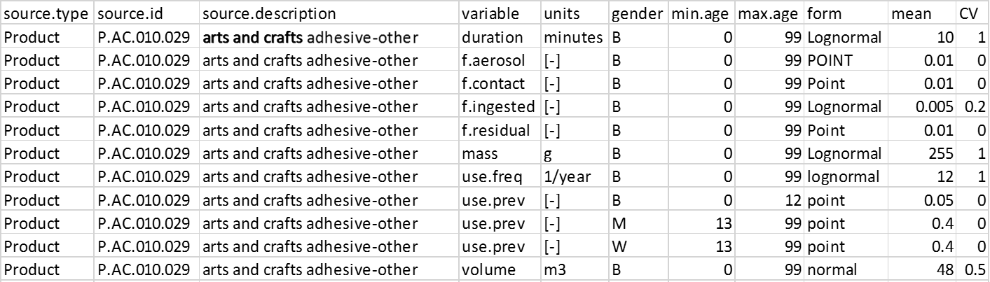
Source–Variable File
SHEDS Technical Manual Section 3.3.12.

Slide 70
Source–Variable File
SHEDS Technical Manual Section 3.3.12.
Source Information

Slide 71
Source–Variable File
SHEDS Technical Manual Section 3.3.12.
Source Information
Source-specific variables*
*SHEDS will write error if a scenario is missing a required variable

Slide 72
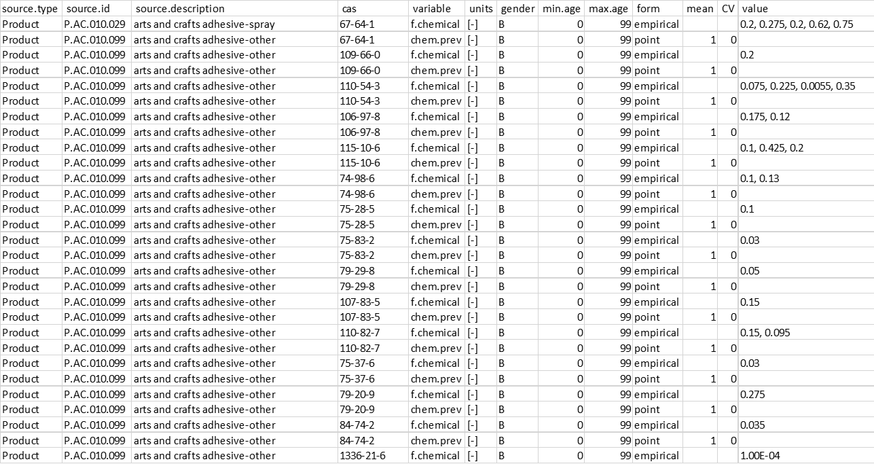
Source–Chemical File
SHEDS Technical Manual Section 3.3.11.

Slide 73
Source–Chemical File
SHEDS Technical Manual Section 3.3.11.
Source Information

Slide 74
Source–Chemical File
SHEDS Technical Manual Section 3.3.11.
Source Information
Chemical
*Chemical-Specific Variables Parameters
(here weight fraction and chemical prevalence)
*SHEDS will ignore chemical if missing a required variable

Slide 75
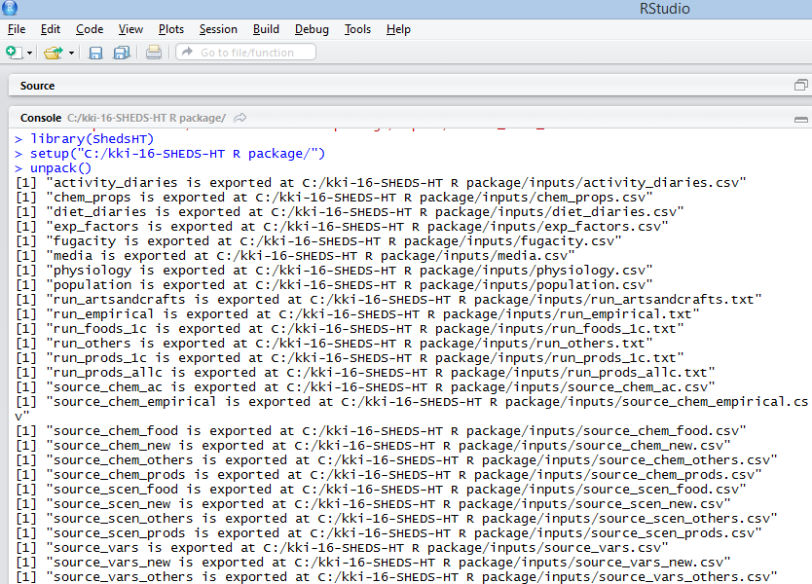
Performing a Run
We will cover details in Part IV Tutorials
Install R Package and dependencies
Load R package: >library(ShedsHT)
Set up SHEDS directory >setup(path)
Unpack input files >unpack()

Slide 76
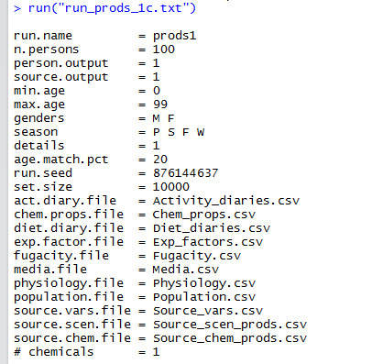
Performing a Run
We will cover details in Part IV Tutorials
Install R Package and dependencies
Load R package: >library(ShedsHT)
Set up SHEDS directory >setup(path)
Unpack input files >unpack()
Call Run: >run(“runfile.txt”)

Slide 77
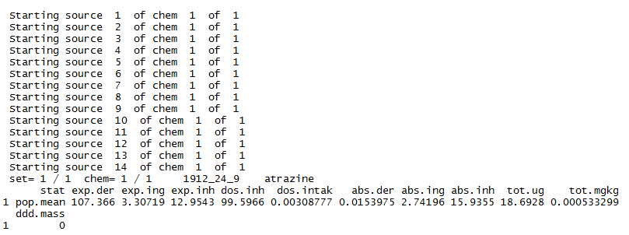
Performing a Run
We will cover details in Part IV Tutorials
Install R Package and dependencies
Load R package: >library(ShedsHT)
Set up SHEDS directory >setup(path)
Unpack input files >unpack()
Call Run: >run(“runfile.txt”)

Slide 78
SHEDS Output Files
SHEDS Technical Manual Section 3.4.
Created in new folder in “Outputs” directory with the same name as the Run
Comma-separated value (CSV) files
Each output file is chemical-specific, each file name is appended with chemical name (usually CASRN)
For large number of individuals, SHEDS runs multiple “sets” for optimizing speed. Some files are written for each set and are combined at the end of the run and given an “_all” extension.
Three types of output files: All Individuals, Source Means, and Statistics

Slide 79
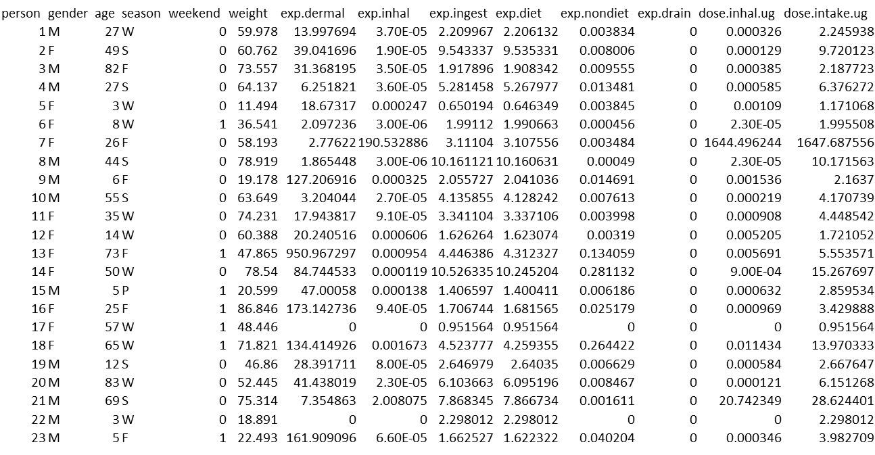
The All Individuals Output File
Exposure and dose metrics for every simulated individual for the chemical
…
…
SHEDS Technical Manual Section 3.4.1.

Slide 80
The Statistics Output File
Population statistics by cohort (Total, M>F, age groups, women of childbearing age) for select exposure/dose metrics
SHEDS Technical Manual Section 3.4.2.

Slide 81
The Source Means Output File
Mean Exposure Metrics Across Individuals for Each Source for Chemical
SHEDS Technical Manual Section 3.4.2.

Slide 82
Post-Processing For Further Analysis
>combine_output(run.name, out.file, metrics)
Combines results from all chemicals into one file
run.name -name of run to process
out.file - filename to create
metrics – percentiles to include e.g. metrics = c(“5%”, “50%”, “75%”, “95%”, “99%”, “mean”, “sd”)
…
SHEDS Technical Manual Section 5.

Slide 83
To be continued in Part IV - Tutorial

Slide 84
Acknowledgements and Disclaimer
Although this work was reviewed by EPA and approved for publication, it may not necessarily reflect official Agency policy.
External Collaborators
Deborah Bennett, UC-Davis
Henry DeLima, DeLima Associates
SHEDS-HT Development
Kristin Isaacs, ORD
Halûk Özkaynak , ORD
Peter Egeghy, ORD
Rocky Goldsmith, ORD
Graham Glen, Alion
Chris Grulke, ORD*
Raina Brooks, SSC
Daniel Vallero, ORD
Luther Smith, Alion
Rapid Exposure and Dosimetry/ExpoCast Team
NCCT
Chris Grulke
Richard Judson
Dustin Kapraun*
Thomas Knudsen
Chantel Nicolas*
Robert Pearce*
Risa Sayre*
Woody Setzer
Imran Shah
Rusty Thomas
John Wambaugh
NRMRL
Xiaoyu Liu
NERL
Craig Barber
Derya Biryol*
Kathie Dionisio
Peter Egeghy
Kristin Isaacs
Seth Newton
Katherine Phillips
Paul Price
Mark Strynar
Jon Sobus
Mike Tornero-Velez
Elin Ulrich
Dan Vallero
Barbara Wetmore
NHEERL
Jane Ellen Simmons
Marina Evans
Mike Hughes
SHEDS-MM Development
Jianping Xue, ORD
Valerie Zartarian, ORD
Halûk Özkaynak, ORD
NERL Leadership
Jennifer Orme-Zavaleta
Jay Garland
Tim Buckley
John Kenneke
ORD Chemical Safety for Sustainability Program
Tina Bahadori
John Cowden
*Trainees

Slide 85
Extra Slides (for addressing questions)

Slide 86
Initial Case Study: Summary of Chemical Exposure Scenarios
Scenario | Number of Chemicals | Number of Consumer Product Categories | Number of Products
Dietary | 330 | - | -
Direct Dermal | 2203 | 229 | 18847
Direct Ingestion | 303 | 6 | 566
Direct Inhalation of Aerosol | 1099 | 62 | 6100
Direct Inhalation of Vapor | 1979 | 164 | 13743
Indirect | 945 | 77 | 6684

Slide 87
Initial Case Study Results
Percentiles of total
intake dose for all ages
Mean total intake dose by age/gender cohort, sorted by the mean values for children ages 0-5 years

Slide 88
Initial Comparisons with Data
SHEDS-HT predicted chemical intake doses compared to oral equivalent intake doses inferred from NHANES biomarker data for 39 chemicals (Wambaugh et al., ES & T, 2013). Left: SHEDS median intake dose versus biomonitoring-based predicted median intakes. Right: SHEDS 5th,50th ,95th percentile predictions compared to median inferred predictions using NHANES with uncertainties.

